Slide 1
Java
UNIT 3(a)

Slide 2
Class
A class is a user defined blueprint or prototype from which objects are created. It represents the set of properties or methods that are common to all objects of one type. In general, class declarations can include these components, in order:
Modifiers : A class can be public or has default access
Class name: The name should begin with a initial letter (capitalized by convention).
Superclass(if any): The name of the class’s parent (superclass), if any, preceded by the keyword extends. A class can only extend (subclass) one parent.
Interfaces(if any): A comma-separated list of interfaces implemented by the class, if any, preceded by the keyword implements. A class can implement more than one interface.
Body: The class body surrounded by braces, { }.

Slide 3
Object declaration
Using new keyword is the most basic way to create an object. This is the most common way to create an object in java. Almost 99% of objects are created in this way.

Slide 4
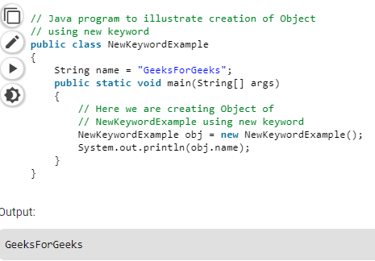
Object declaration

Slide 5
Object reference variable
We can assign value of reference variable to another reference variable.
Reference Variable is used to store the address of the variable.
Assigning Reference will not create distinct copies of Objects.
All reference variables are referring to same Object.

Slide 6
Object reference variable
Synytax:
Rectangle r1 = new Rectangle();
Rectangle r2 = r1;
r1 is reference variable which contain the address of Actual Rectangle Object.
r2 is another reference variable
r2 is initialized with r1 means – “r1 and r2” both are referring same object , thus it does not create duplicate object , nor does it allocate extra memory.

Slide 7
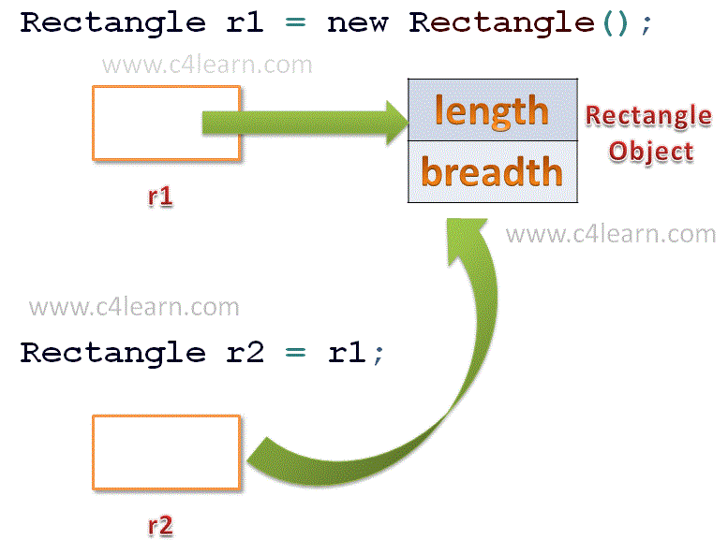
Object reference variable

Slide 8
Object reference variable
Assigning Object Reference Variables does not-
Create Distinct Objects.
Allocate Memory
Create duplicate Copy

Slide 9
Object reference variable
Example:
class Rectangle
{ double length;
double breadth;
public static void main(String args[]) { Rectangle r1 = new Rectangle();
Rectangle r2 = r1;
r1.length = 10;
r2.length = 20;
System.out.println("Value of R1's Length : " + r1.length); System.out.println("Value of R2's Length : " + r2.length); } }
Output: Value of R1's Length : 20.0
Value of R2's Length : 20.0

Slide 10
Methods
A method is a collection of statements that perform some specific task and return the result to the caller.
Methods allow us to reuse the code without retyping the code.
Methods are time savers and help us to reuse the code without retyping the code.

Slide 11
Method Declaration
In general, method declarations has six components :
Modifier-: Defines access type of the method i.e. from where it can be accessed in your application. In Java, there 4 type of the access specifiers.
public: accessible in all class in your application.
protected: accessible within the class in which it is defined and in its subclass(es)
private: accessible only within the class in which it is defined.
default (declared/defined without using any modifier) : accessible within same class and package within which its class is defined.

Slide 12
Method Declaration
The return type : The data type of the value returned by the method or void if does not return a value.
Method Name : the rules for field names apply to method names as well, but the convention is a little different.
Parameter list : Comma separated list of the input parameters are defined, preceded with their data type, within the enclosed parenthesis. If there are no parameters, you must use empty parentheses ().
Method body : it is enclosed between braces. The code you need to be executed to perform your intended operations.

Slide 13
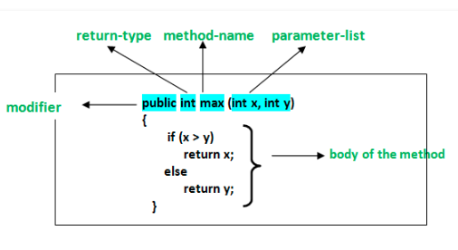
Method Declaration

Slide 14
Method overloading
Overloading allows different methods to have the same name, but different signatures where the signature can differ by the number of input parameters or type of input parameters or both.
Overloading is related to compile time (or static) polymorphism.

Slide 15
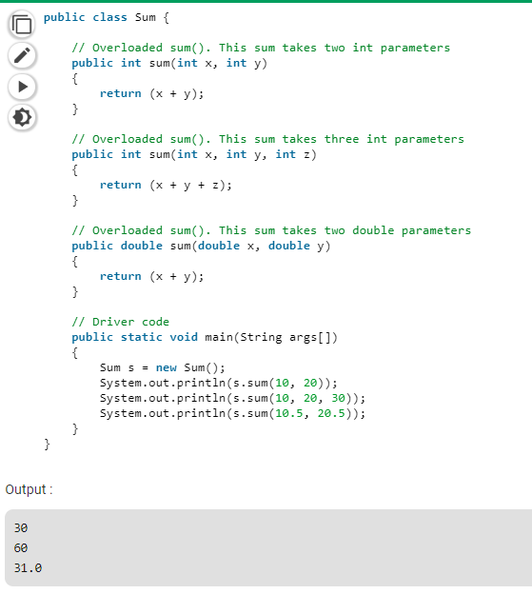

Slide 16
Constructor
In Java, a constructor is a block of codes similar to the method. It is called when an instance of the class is created. At the time of calling constructor, memory for the object is allocated in the memory.
It is a special type of method which is used to initialize the object.
Every time an object is created using the new() keyword, at least one constructor is called.
It calls a default constructor if there is no constructor available in the class. In such case, Java compiler provides a default constructor by default.
There are two types of constructors in Java: no-arg constructor, and parameterized constructor.

Slide 17
Rules for creating Java constructor
There are two rules defined for the constructor:
Constructor name must be the same as its class name
A Constructor must have no explicit return type
A Java constructor cannot be abstract, static, final, and synchronized

Slide 18
Types of Java constructors
There are two types of constructors in Java:
Default constructor (no-arg constructor)
Parameterized constructor

Slide 19
Default constructor
A constructor that has no parameter is known as default constructor.
If we don’t define a constructor in a class, then compiler creates default constructor(with no arguments) for the class. And if we write a constructor with arguments or no-arguments then the compiler does not create a default constructor.

Slide 20
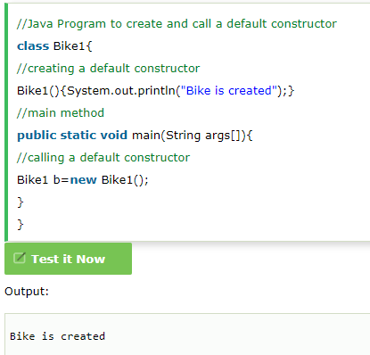
Default constructor

Slide 21
Parameterized Constructor
A constructor that has parameters is known as parameterized constructor.
The parameterized constructor is used to provide different values to distinct objects. However, you can provide the same values also.
If we want to initialize fields of the class with your own values, then use a parameterized constructor.

Slide 22
